Slide 1


2O16: A VRT ODYSSEY

Slide 2

Where Do We Want to Go?
Increased usability
Integrated reports
Better data quality
Confidently measure results

Slide 3
Strategic Plan
Move away from legacy systems
Modern tracking, analysis and reporting applications
Focus on ease of maintenance, access and data integration
Enable High Quality Data
Go mobile
Notes:
Changes are grounded in Strategic Plan
Silverlight was best solution for previous offline access requirement, but will become a legacy application within coming years
Silverlight no longer developed by Microsoft – was good but not now
Goal to move away from legacy applications
Ability to connect and link databases; if databases are correlated we can get better information
Modern tracking ability -> easy database maintenance, easy data access, ability to integrate data for correlations
Need solution for use on mobile devices
Strategic Obj. 11: “Advance ability to measure progress, improve performance, and demonstrate impact”
Strategic Obj. 10: “Enable seamless communication and collaboration for all Volunteers and staff by modernizing and integrating information technology systems and leveraging the innovation of Volunteers and staff in the field.
Strategic Obj. 3: “Advance community-based development by strengthening the capacity of local individuals and communities, focusing of highly effective technical interventions and leveraging strategic partnerships”

Slide 4
Instructions from Carrie
Be bold
Make it simple
Trust our people
Peace Corps’ magic
Notes:
“Magic” - Need a system to not just tell us what we do, but be able to capture and tell what we do uniquely well
Tell our stories – focus on what we do “uniquely” well

Slide 5
Note on Change Management
“Change fatigue is palpable”
– D. Baker (DPT Ethiopia)
Maximize utility of change
Minimize the perception of change
Notes:
Dan’s quote.. you can feel and see the weight of change among staff
Country Directors have also messaged to “slow down”
Simplify – changes should be a simplification
Major changes are done in the background and when possible, made invisible to the User Interface
Changes should reduce workloads

Slide 6
Proposed Changes
Create Web App
Unify Data Access
Integrate SR
Centralize Database
Link to Other Databases
Work Planning
Track Changes
Redesign Data Structure
Data Cleaning Toolkit
Outcome-based reporting
Case Reporting
Site –Focused (vs. PCV Focused)
Log Results (vs. Reporting)
Upload Attachments
Notes:
Many of these changes will be “under the hood” and will not be perceived as massive changes by users because they will not affect the User Interface (UI). Some changes will affect the user experience and care should be taken to minimize the perception of change.
For example, an ability to attachment documents and pictures is so common in software that, while it’s implementation needs to be carefully thought through, the perception of change on the part of the user will be minimal. Similarly, the “web-app” does not in itself require a change of the UI. Other functions that build on to the existing UI will either integrate existing systems or improve ability to perform existing tasks.

Slide 7
Centralize Database
Current –
Decentralized,
Offline Application (Volunteers)
& Web Application (staff)
Notes:
Note the number of steps for data to go from the Volunteer to the central database - 4
Note the number of development environments – 2 (Silverlight and the Web App)
> For developers, requires two environments to learn, build, test, deploy
Substantial menial labor for APCDs managing the back and forth of VRF Files.
> APCD/PM needs to create VRFs for each Volunteer in the web app
> APCD/PM then sends these VRFs to Volunteers.
> Volunteers must download Silverlight app to open and access VRFs.
> After completing their VRFs Volunteers must attach VRF to email and send to APCD.
> APCD then must place VRFs in proper folder and import into the VRT.
Things go wrong. More pieces = more possible places for things to go wrong; requires more and challenging troubleshooting.
VRF is available offline, but only accessible only on Windows and Mac; not accessible on iOS, Android, WP, or Linux.
Currently requires internet access to download VRF application to open the VRF file

Slide 8
Centralize Database
Proposed –
Centralized, Web Applications
Notes:
How we’d like it to look
One database and web-app for all users
Instead of multi-staged process – create a web-app that talks to everyone
Decrease data path = less errors = less menial time
Data directly reported into database
Cons: need to access Internet at a point of time to report during a time period
Advantage: accessible on any device that supports Internet/html
No challenges with the type of technology the Volunteer or staff choose to use
Easier to develop and quicker to update = one, web-based environment
APCDs menial labor role decreases; path to database decreases; data quality increases; time available to support Volunteers on the work they reported increases
“Performance Goal 3.3: Improve Feedback to Volunteers
Increase the percentage of Volunteers who report “considerable” or “exceptional” satisfaction with the timeliness and quality of feedback provided on their work”

Slide 9
Create Web App
5 Reasons for a Web App
Mobile
Change Management
Lower Complexity/Cost of Development
Enables ongoing reporting (Data Quality)
APCD/DPT/IT specialist time
Notes:
Mobile and platform independence: Available on any device
Change management: fewer developer environments; much faster to roll out and update
Cost of development decreases over time as number of steps removed, freeing up labor and time
Enables ongoing report to increase data quality – just in time reporting/logging
Reduces menial tasks and troubleshooting; frees professionals up to use their expertise elsewhere

Slide 10
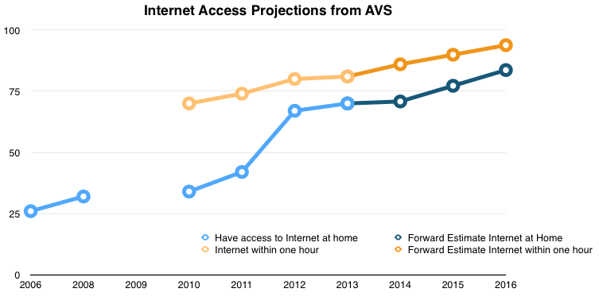
Create Web App
Why a Web App is Feasible
95%
81%
85%
70%
Notes:
Assumed linear trend 95% within the hour/ 85% at home by end of 2016 (note: color variation not very good in black & white)
Trends in AF and Islands suggests access is rapidly increasing – desire to plan for the future
Increase is due to mobile technology access internet is increasing (3G), but still low-bandwidth
Again, desire to plan for the future: Internet accessible, but built for low-bandwidth – opportunities to support the remaining 15% with offline capable tracking apps that can upload results into web-app

Slide 11
Web App Challenges
Limited Internet Access
Low bandwidth
Distribution of PCVs with >1h Travel to Internet 2013
Outer Islands | Rural Village | Rural Town | Cities
2% | 70% | 25% | 3%
Potential Web App Solutions
Investment in Internet access hardware for PCVs and regional centers, funds for travel
Factor 3G cell Internet access into site selection
Accept slower/more limited reporting from Volunteers in areas of limited Internet access
Digital tracking booklets, bulk upload capable
Notes:
How do we resolve accessibility issues?
Two issues: Low-bandwidth; no Internet – different issues/locations
Handle them separately
Connect solutions to the issues & % of population
Digital Tracking Booklet – Office of Innovation ideas
Explore creative solutions for those with limited Internet
Factoring 3G cell internet access into site selection – NOTE: Many already do this for safety and security reasons; cell access is growing extremely rapidly. This should not substantially impact site placements or prejudice against rural sites.
Limited access will be a small problem in 2016 and progressively get smaller. But it’s useful to look at where that problem is distributed. In terms of overall numbers, the limited Internet access Volunteers are overwhelmingly in rural villages. The Internet access of choice in these areas will be 3G mobile internet, not landlines. And that means mobile and low-bandwidth.
“Design flexible systems, platforms, and processes to be compatible with evolving technology (e.g., mobile devices)” (Strategy of Strategic Obj. 10)

Slide 12
Create Web App
Current – Decentralized, Post-dependent Method
Volunteers
Post
PC/W
Run report designed for post use
Run report designed for post use
Run report designed for post use
MYSQL access for advanced needs
Forward report to PCV
OR develop secondary report tailored to PCV needs
SRs and other data calls
Notes:
Volunteers need/rely on APCDs/DPTs to run reports and share results of data
DPT/APCDs are currently central to getting all other users’ data

Slide 13
Create Web App
Proposed – Unify Method
Volunteers
Post
PC/W
Run report designed for PCV use
Run report designed for post use
Run report designed for PC/W use
SQL access for advanced needs
Common report generating system for all users
Flexible permissions system that allows business users to specify who may have access to a given report
(Similar to permissions that exists in Hyperion)
Notes:
Needs: Flexible permissions system
Tie points to the Strategic Plan:
“A globally-connected agency, supported by a flexible IT system and invigorated by field-based experimentation and problem solving, will leverage modern technology to break down barriers to communication and collaboration.”
“Build modern tracking, analysis, and reporting applications that enable easy database maintenance, data integration, and data access” (Strategy of Strategic Obj. 10)
Highlight the type of data in different sources:
PCVs – Data about past activities done at site and their results, measurements of reporting cohorts, peer activities, promising practices, etc.
HQ – Post analysis (see SR section next)
Posts – Enhanced reports providing them with Summary Reports that support ongoing project management and Volunteer support
Build in filters to meet users needs
Provide visualizations of quantitative data to improve usability
Desire to incorporate ability to use keyword searches to narrow results down

Slide 14


Create Web App: Integrate SRs
Current – Un-automated Process
Into an Excel “scratchpad” for data cleaning
Run extract
Run report
Into an Excel
SR template
Into PDFs for sector specialists and CDO
Summary Sheets
Into an Excel “Database” for cleaning and aggregate analysis
PDFs into Excel for analysis
And others
Notes:
Un-automated process
Requires substantial amount menial labor to put and pull data from Excel files in order to receive and compile data.

Slide 15
Create Web App: Integrate SRs
Proposed – Integrated Process, Increase Time for Reflection
Data Cleaning Toolkit
Form for Collecting Reflection and Analysis
+ APCDs, CDs, DPTs, OPATS, OGHH,
CSPP, Initiatives, OGO, OSIRP, etc.
Run a Report
Notes:
Note separation of data cleaning and reflection/analysis.
Desire to provide post staff with tools to expedite and improve data cleaning/review process.
Once data is clean and verified by post, PC/W data users will be able to use system to generate reports automatically.
Reduces time of staff spent on data transfer; allowing for SR process to focus more on reflection and analysis.
PC/W will have access to data in VRT database
SR templates will adjust to focus on reflection-driven questions; asking staff to reflect on results from previous year and plans moving forward

Slide 16
Track Changes
Current – Staff Overwrite Data during Cleaning
No record of who made the edit
No record of why an edit was made
No audit trail
Propose – Move to a journaling, or non-destructive editing, paradigm
Each edit is tagged with the user, timestamp, and a notes field
Notes:
VRT is now an official data source to monitor progress towards our Strategic Plan, elevating the importance of users cleaning and maintaining its database.
Enable tools to track changes, which will allow system to “trust staff and users” to correct errors themselves
As with the report access, access to the edit information will be controlled by permissions.

Slide 17

Track Changes
Advantages:
Audit Trail -> Data Quality
Identification of consistent sources of data entry error
Streamlining user experience
Fewer data deletion warnings
Undo
Notes:
Data transparency in audit trail
You’ll know what may be reliable and what isn’t reliable by tracking the number of corrections need to be make on certain areas of reports
Connect this to desire to “trust people”
Won’t know where there is confusion or system way to keep track of where most frequent cleaning is taken place

Slide 18
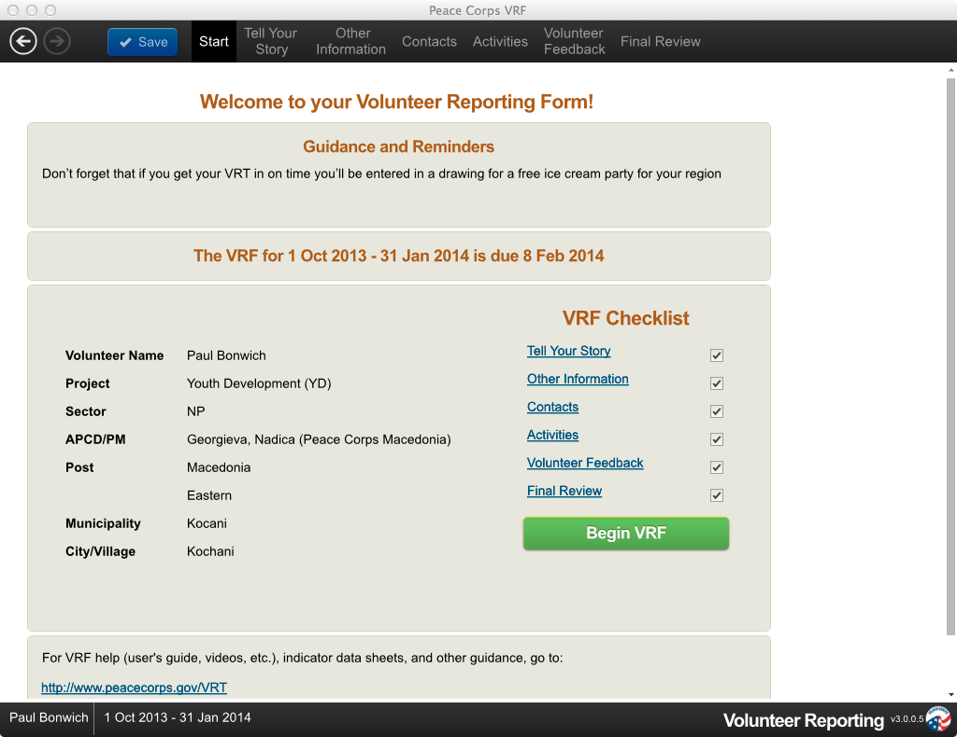
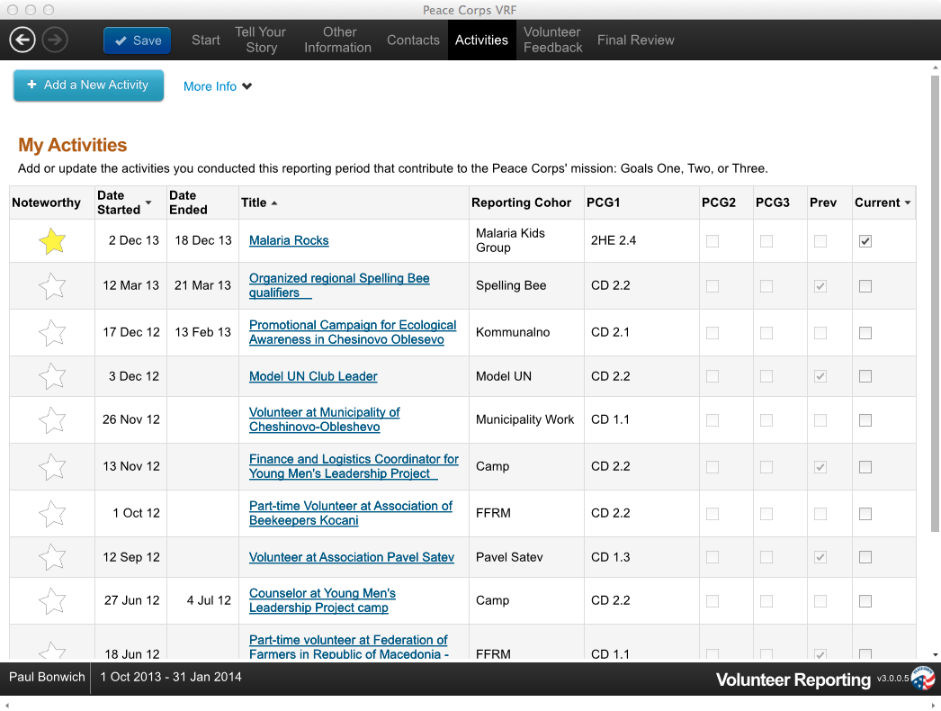
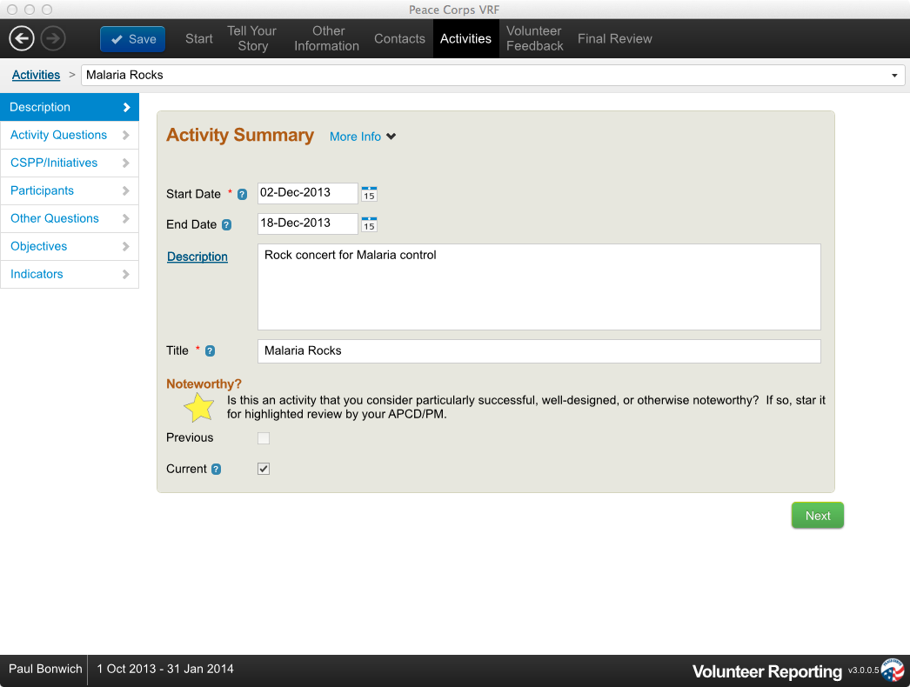
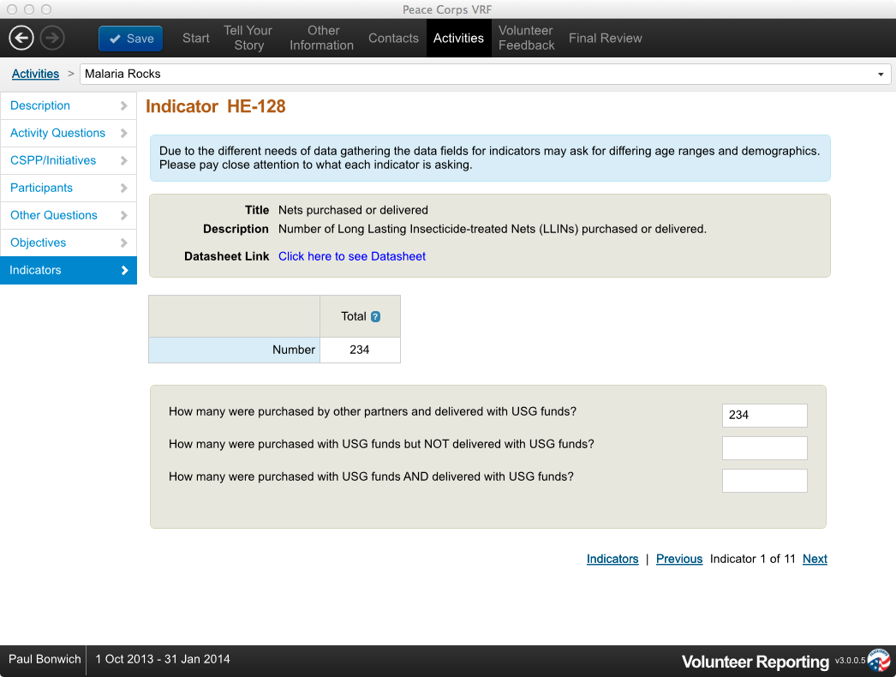
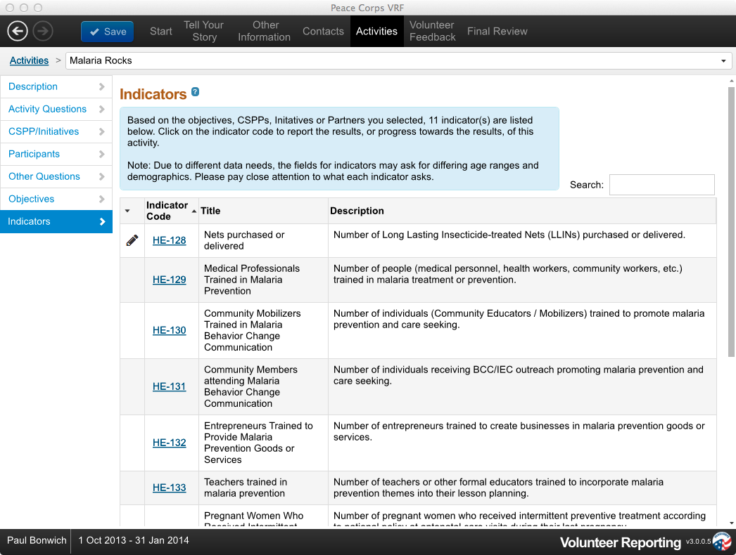
Track Changes
Current –
5 screens to drill down to a single data point you want to edit.
Notes:
Current – Data cleaning:
Labor intensive and repetitive
Data can only be cleaned one VRF at a time
Staff routinely export data to Excel for cleaning – the data within the VRT remains raw
While cleaning, staff cannot compare data across Volunteers or Time Periods
Emphasize one VRF at a time – using an interface designed for data collection, not for cleaning
Requires manual re-entry into actual VRF to save edits/corrections made to exported reports OR re-clean data that has already been cleaned
Capability exists in current DOVE system – need to have permissions and train users along with data audit trail technology to track changes
No comparability across Volunteers

Slide 19
Track Changes
Proposed – Data Cleaning Toolkit:
Edit in tabular mode (to compare across Volunteers and time periods)
Track changes to edits; data audit logs
Flag suspicious data points for follow up
Automatic flags on statistically anomalous data
Ability to drill down to activity narratives
System disallows conflicting data during entry
Tools for “clean as you go”
Notes:
See in table form what you want to see compared to the others; easier to spot anomalies/outliers
Ability to track changes
Ability to drill down without manually having to click back through actual VRF
Auto flag anything that is 2 standard deviations away from mean – to call attention to check
Some repeated info from editing/track-changes ability

Slide 20
Log Results (vs. Reporting)
Current – Reporting = Infrequent entry of substantial amounts of data
Proposed – Logging = Frequent entry of small amounts of recent data
Advantages:
Increases timeliness and reliability
Flexibility of data cleaning
Current data for site visits
Reduces complexity of the data structure
Notes:
Reporting: What we do, status quo – 3-6 month timeframe
Logging is feasible when using web-app (not when relying on email)
Data cleaning is time consuming; flexibility to do when occurring – if desired, not necessary
Now: clean 6-12 months of reported work; Hope: a little now and then throughout year
Site visit data can be 6 months old, instead of data from last week
Opportunity to replace unnecessary needs assessments/emails asking for mid-report updates prior to visit
Doesn’t remove Reporting Period timeframe; still a business process, just not hard-coded into the system
Reduce complexity – won’t need reporting period, but can set a date range/time frame
Can log, but wouldn’t have to immediately; Support those with limited access with a Digital Tracking Booklet
Allow for more flexibility to questions that need to be answered less frequently (i.e., Tell Your Story)

Slide 21
Redesign Data Structure
Peace Corps’ Magic
What do we do better than any other development organization?
Consistent behavior change with groups over time
Understanding the key influencers in a community – the counterpart relationship
Synergy of many interactions leads to Increased Understanding
How do we “measure for results” of our unique value proposition?
Notes:
Data structure is key to be able to tell our collective story well
Connect to Strategic goals / Performance Goal 3.2:
“Performance Goal 3.2: Strengthen Local Capacity
Increase the percentage of projects with documented gains in the capacity of host country individuals”
Magic: Volunteer in village over two years
Volunteers collaborate with a counterpart –
Need to show how all activities synergize to lead to outcomes
Goal 2 & 3 both require consistent long term thinking and results come from cumulative interventions.
Bottomline: How do we measure our unique value proposition?
We don’t current with activity to outcome approach; we want to be able to say outcome is result of group of activities, but currently cannot

Slide 22

Current – “Activities Reporting”
Redesign Data Structure
Output
Indicators
Outcome
Indicators
Activities
System enforces a direct link between outcome indicators and a unique activity.
Example: You run a leadership camp with youth, a separate afterschool program, and a monthly weekend program. To report on the Outcome Indicator: “Life Skills – decision making and critical thinking,” you MUST associate it directly with one of those activities.
Does not support process indicators (e.g., hours worked, amount of prep time, resources used)
Notes:
Structure built requires outcomes to link directly to a single activity -> 1:1 link
How do we know the work we are doing is a best practice?
How do we know what it takes to have a successful activity?
How do we know if Volunteers were prepared to successfully conduct the activity?
Are volunteers trained to do the work they do

Slide 23

Proposed – “Activities and Observations Reporting”
Redesign Data Structure
Activities
Output indicators remain linked to activities
Process indicators added
Observations of outcomes no longer restricted to 1-to-1 relationship with an activity, allowing measurements of outcomes that are the result of multiple activities.
Output
Indicators
Outcome
Indicators
Process
Indicators
Activities
Output
Indicators
Process
Indicators
Notes:
Many to one relationship between activities and outcomes that collectively lead to outcomes
Largest change to user / Largest structural change / will require training and support
Need change management to train and adjust format of reporting
Currently train and spending time to develop materials to support post in explaining to Volunteers how to report properly because design not built to how Volunteers intuitively want to report and/or how Volunteers conduct activities/projects
Agency growing away from reporting outputs/number of beneficiaries reached – to wanting to document and report outcomes/changes/results – eventually impact

Slide 24
Redesign Data Structure
Foundation of Measuring for Results
Near term process improvement
Baselines, Mid-term, End line
Community Needs Assessments
Lay groundwork for increased M&E Rigor
(when Peace Corps business processes are ready)
Quality assurance of observations by next Volunteer or third party
Population-based measures
Proportions
Samples
Impact (on all 3 goals)
Notes:
Flexible system to allow for observations overtime
Currently VRT does not support collecting observations/measures taken overtime that are outside of an activity
Opportunity to incorporate community needs assessment which currently exists outside the VRT system and requires post to track and set up and additional database to compare overtime
Structure to allow for more rigorous M&E in the future
Connect to Per Goal 3.1 & 3.2
“Performance Goal 3.1: Advance Community-Based Development Outcomes
Increase the percentage of projects with documented gains on community-based development outcomes
Performance Goal 3.2: Strengthen Local Capacity
Increase the percentage of projects with documented gains in the capacity of host country individuals”

Slide 25
Redesign Data Structure – Report Cohorts
Current –
Enforces 1-to-1 relationship with activities
January
February
March
Does a weekend program with:
Does an afterschool program with:
Does a spring break camp with:
Young Leader’s Association
The
Environmental Club
Young Leader’s Association
&
The Environmental Club
No good way to report this in the current VRT
Notes:
Related to delinking activities and outcomes
Inherent complexities to collecting data; desire to build tool to minimize – not complicate

Slide 26
Redesign Data Structure – Report Cohort
Proposed
Remove 1-to-1 relationship with activities
Better tools to handle changes to reporting cohort membership over time
Optional module for case reporting (by individual) of key behavior change outcomes
Advantages
Crucial for data quality – avoid double counting
Substantial field feedback on this restriction
Notes:
Most needed, most requested fix to make
Purpose: To better document who achieved results and to reduce double counting
Ability to include Case Reporting – something PEPFAR and health projects might be seeking to do to meet partnership and local ministry requirements

Slide 27
Redesign Data Structure – Site Focused
Site, or program, Focused Reporting
(vs. Volunteer Focused)
Improve continuity of multiple generations of Volunteers at a site
Reporting Cohort carryover
Visibility of past activities in a geographic location
Greater visibility of Volunteer’s contribution to the project as a whole
Greater comparability – PCV -> peer group
Ability to return in 5 years and look at longer-term outcomes
Notes:
Tie into the earlier comment about preparing for future effort/changes in business processes
If Strategic Plan desires to:
Establish an environment conducive to Volunteer success through an integrated approach to developing effective project, preparing work sites, and successfully collaborating with local partners. Establish well-defined and meaningful work opportunities for Volunteers by selecting sites with well-documented needs. (Strategic Obj. 7: Site Development)
Increase the percentage of projects with documented gains on community-based development outcomes. (Performance Goal 3.1)
Advance the agency’s ability to measure progress, improve performance, and demonstrate impact through integrated monitoring, reporting, and evaluation practices. (Strategic Obj. 11)
Having a method to document and continue reporting on outcomes across multiple generations of Volunteers is essential.
Site history is kept and documented in post-specific methods. Opportunity to integrate systems and connect Volunteers VRFs to site history information.

Slide 28





Current – Verification: Paper Audit Trail
Upload Attachments
Folder in Volunteer’s home
Reporting Tools (training sign in, etc.)
Filing Cabinet at Post
Post- level audit
Central audit
VRF
Notes:
From USAID review of Feed The Future:
Program Manager does not verify data by comparing data on training sign-in sheets or other project related data forms completed by Peace Corps Volunteers.
Peace Corp Office in Washington does not verify data it receives from the Program Manager or provide feedback to the Program Manager on data quality
The results reported to USAID by Peace Corps for FY 2012 and FY 2013 Semester 1 do not match results in electronic reports found at the Peace Corps office in Togo for the same periods
Partners want to verify that the $$ spend when to the number of people it was intended for; require documentation that can verify (e.g., sign in sheet with signatures)
New standards and expectations for development; anticipate more funders and development agencies will adopt similar expectations of current partners
Current process at PC being developed requires documenting and keeping a paper-based audit trail; requires two processes for post to keep track of: VRF results reported and original tools to collect and document results
Laborious to document, track, and connect during audits
Will increase over time as we continue to partner with new organizations
Purpose: to improve the audit trail, improve process and ability to verify results reported
Increase data quality
Attach to VRF file
Opportunity to build a system to support anticipated partnership requirements

Slide 29

Proposed – Verification: Electronic Audit Trail
Upload Attachments
Photo of Tool (or excel file, pdf, etc.) attached to activity or observation
Web App
Reporting Tools (training sign in, etc.)
Post- level audit
Central audit
Notes:
Removes need to use people to file and sort to keep track of records
Ability to drill down to tool with conducting an audit
Purpose: Improves audit trail for Congress and Partnerships
Keep all documents stored centrally in a system that can be managed throughout staff turnover
Need to explain DQA / spell out more clearly; call out partners/funders that require this
Suggest direction PC moving it.. higher standards for data quality – assessing/tracking/monitoring data quality anticipated in future for all projects/work

Slide 30
Enhance Volunteers’ Success Stories
Upload Attachments
OR
Attached to activity or observation
Web App
Success Story, Case Study, How to Guide, etc.
OR
Attached URL
Web App
Database stores a web archive of blog post
Volunteer Blogs
Notes:
Capturing quick and easily what’s already being worked on and shared – resharing with larger audience
Volunteers spend time on success stories, but they are putting them in their blogs – propose attachment ability that accepts URLs and archives blog posts
Download and store web-archive so we don’t lost them when Volunteers leave
Senior Leaders/Carrie desire to better tell and share Volunteers’ stories
Current text box is limiting for purposes beyond post use
PC desires to learn more and share more about successes documented and told by Volunteers
Desire for better written and more thorough work
Suggestion: PeopleSoft? PC/Facebook and PC/blog connections – connect to Comm’s page? PCLive
Opportunity to develop guides, templates, etc.

Slide 31
Centralize Database: Integrate with Other DBs
Questions We Currently Can’t Answer:
“What are the characteristics of a site where Volunteers are most successful?” (VIDA)
“Do Volunteers who receive X training do better work than Volunteers who receive Y training?”(TSRs… ish)
“What programs or activities should I assign people with X skill set to in order to insure the best outcomes in the field?” (DOVE)
Notes:
Strategic Plan:
“Build modern tracking, analysis, and reporting applications that enable easy database maintenance, data integration, and data access”
“Performance Goal 11.2: Increase Evidence-Based Decisions
Increase the percentage of posts and headquarters offices that demonstrate the use of evidence in program, policy, and/or budget decisions to 100 percent by FY 2016”
- Cannot answer these questions without correlating VRT data with other databases:
- Acknowledge it will require collaboration/integration between stakeholders of the other systems

Slide 32
Centralize Database: Integrate with Other DBs
Integrate Training Data into the VRT:
Create a Training Module in the VRT for Training Managers
Create a Training Module in VRF for Volunteers to corroborate Training Manager data
Ability to track online learning, third party trainings, etc. (i.e. TEFL certification)
Allow for full integration of TSR into VRT
Notes:
How do we integrate VRT with training?
Training data exists in TSR – opportunity to integrate the TSR into VRT and allow for more timely reporting on training events
Record time of training events (PST, IST, other workshops and training topics etc.)
Desire to do continue training (online, self-directed, TEFL certificate program requirements)
“Continue to evaluate and refine the training materials developed through FITU strategy” (Strategy of Strategic Obj. 8)
Opportunity for a comparable data point for “Performance Goal 8.2: Increase Effectiveness of Technical Training” Increase the percentage of Volunteers who report that their technical training prepared them to work at their site to a ‘considerable’ or “exceptional’ degree.”

Slide 33
Centralize Database: Integrate with Other DBs
Allow for Additional Integration:
Link to VIDA: Ability to run reports that correlate outcomes to site characteristics
Link to DOVE: Ability to run reports that correlate outcomes to Volunteer characteristics
Build hooks to allow for flexible correlation of VRT data to other data sources
Notes:
New VIDA – connect to Strategic plan for reference of strategy/plan to update
Ability to recognize the same Volunteer across all systems
VIDA has coding of sites and location information
PCGO?
PAR?
AVS?
Odyssey (for TAD trainings)?
Do Volunteers who get SPA money implement activities that have more successful outcomes?
Do Volunteers with Internet have more success?
Need to develop VRT with “Hooks”
Want to be able to correlate with other data sources

Slide 34
Centralize Database: Work Plan Module
Allow users to create individualized work plans (Staff, Volunteers, and PC/W)
Useful for all Volunteers, particularly for PC Response, 3rd year positions, PCVLs, etc.
Tracks unique metrics not applicable to a formal project framework
Ability to share common management metrics (i.e. # of site visits by PCVL, # of PCV trainings run by 3rd Year Volunteer)
Notes:
The work plan is extremely important for PCVs (not just PCVLs or 3rd years). This is a great tool to enable effective and integrated PTE and ensure high data quality across the service continuum. PC/Belize is a great example of how an integrated workplan in the VRT would allow PCVs to reference training materials, programming resources and MRE tools prior to their activity and to get feedback and support in advance of implementation. PC/Namibia uses a modified project framework to collect data about Volunteers first few months in site. PC/Response wants to support posts in developing reporting structures for PCRVs to use – less formal than Project Framework.
All users could have access to develop their own.

Slide 35
Proposed Changes
Create Web App
Unify Data Access
Integrate SR
Centralize Database
Link to Other Databases
Work Planning
Track Changes
Redesign Data Structure
Data Cleaning Toolkit
Outcome-based reporting
Case Reporting
Site –Focused (vs. PCV Focused)
Log Results (vs. Reporting)
Upload Attachments
Notes:
Many of these changes will be “under the hood” and will not be perceived as massive changes by users because they will not affect the User Interface (UI). Some changes will affect the user experience and care should be taken to minimize the perception of change.
For example, an ability to attachment documents and pictures is so common in software that, while it’s implementation needs to be carefully thought through, the perception of change on the part of the user will be minimal. Similarly, the “web-app” does not in itself require a change of the UI. Other functions that build on to the existing UI will either integrate existing systems or improve ability to perform existing tasks.

Slide 36
General Timeline
FY 2014
FY 2015
FY 2016
> > > Beta Pilot > > >
Report Generator
Centralize Database
Link to Other Databases
Work Plan Module
Basic Access (PC/W)
Create Web App
Unify Data Access (Volunteers)
Integrate SRs
Unify Data Access (PC/W)
Additional Reports
Log Results
Bugs
Track Changes
Upload Attachments
Enhancements
Data Cleaning Toolkit
Redesign Data Structure
Case Reporting
USB Access
Site Focused
> > > Beta Pilot > > >
> > > > > Ongoing Support to Respond to User Feedback > > > > > >
Notes:
FY 2014 – Desire to complete the VRT 3.0 and Improve the Usability of the VRT and VRF through VRT 3.1 update
FY 2015 – Continue to Integrate SRs and develop, or improve, reports
Transition central database to the cloud, building in track changes features and preparing for redesign data structure
Create modified Web App for PC/W
FY 2016 – Create Web App for Volunteers
Deploy Beta Web App to pilot all-web-based system at pilot posts
Desire to Beta Pilot the Web-app prior to full deployment
> Work out bugs without involving all users
> Allow time for support materials to be produced
> Identify solutions and prepare to support users that will have access issues
“Increase the percentage of posts and headquarters offices that conduct structured pilots to test new approaches to advance programmatic goals and/or address management challenges”
**Continued ongoing support to respond to current users issues and feedback**

Slide 37
Recommended Resources*
Hardware and Services:
Bandwidth
Server cycles for LARGE database, many concurrent users
Business controlled permissions management
Ability to test with actual users – beta test suite accessible by HQ + pilot posts + pilot PCVs
*Business Champions estimated resources; actual resource needs should be determined by OCIO based on Business Champion Vision documents
Notes:
Note that OCIO will be the one to really fill out these resources needed lists based on their assessment of the requirements as outlined here.

Slide 38
Recommended Resources*
Human Resources:
UX/UI designer, skill set:
Touch first design; mobile; web design; human-centered design
Developers, skill set:
Web apps for low bandwidth users
Mobile
Knowledge of Chrome, Firefox, Safari, IE
Database structures and querying large DBs
Data Visualizations
*Business Champions estimated resources; actual resource needs should be determined by OCIO based on Business Champion Vision documents
Notes:
Note that OCIO will be the one to really fill out these resources needed lists based on their assessment of the requirements as outlined here.

Slide 39
Recommended Resources*
Process Improvements:
Software for communication between developers and business champions
Mockups
Common requirements tracking system (TFS licenses)
Dedicated Business Champion (BC) lead – full time (distinct from Business Support)
Clear allocation of BC time
Coordinate BC reps and other Business stakeholders
Represent BC reps at all VRT meetings
*Business Champions estimated resources; actual resource needs should be determined by OCIO based on Business Champion Vision documents
Notes:
Note that OCIO will be the one to really fill out these resources needed lists based on their assessment of the requirements as outlined here.

Slide 40

THANK YOU

